Slide 1


ALLSVENSKAN 2021
Season with a photo finish
Axel Reman

Slide 2
Aim
Data
Statistical football terms
Match specific visualization
Seasonal visualizations
Summary

Slide 3
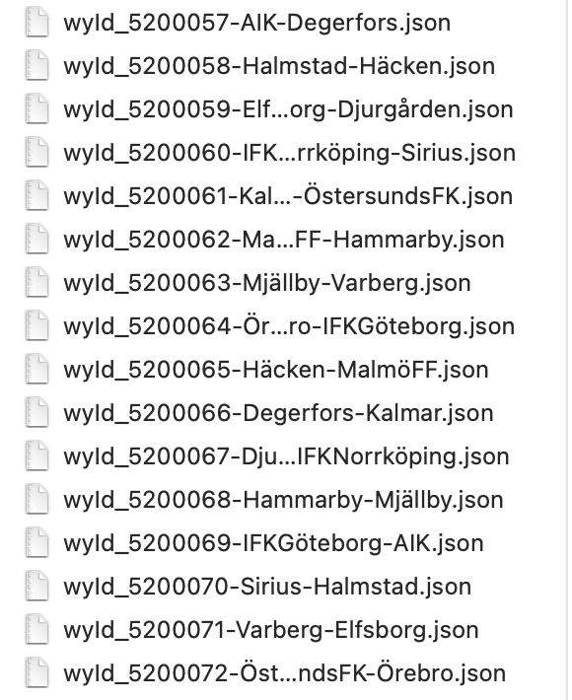
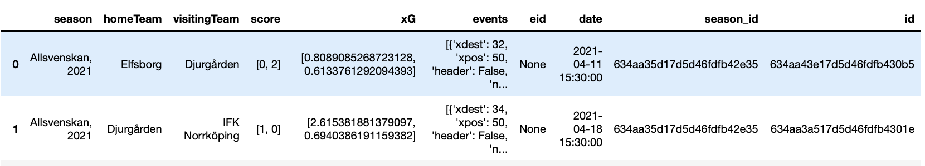
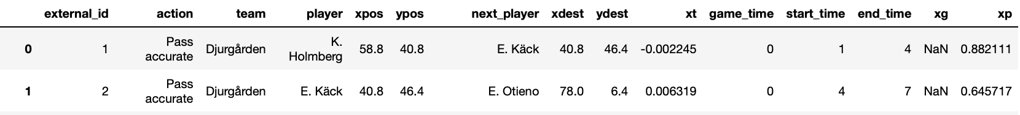
The dataset
240 game files

Slide 4

Football terms
xG
Goal difference
xT
Probability of a shot resulting in a goal
Model based on historical data
Value between 0 and 1
Goals scored
Goals conceded
Aggregated over a full season
Value of possession
Zones of pitch
How dangerous a team is

Slide 5
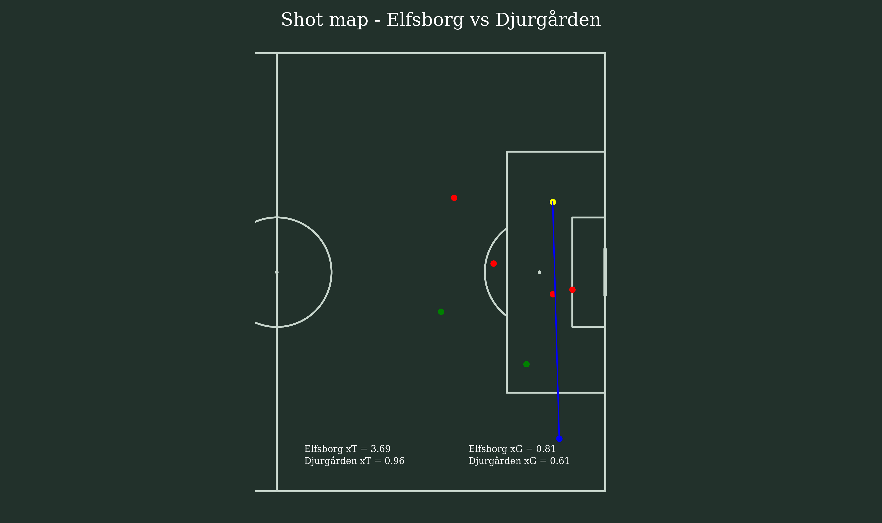
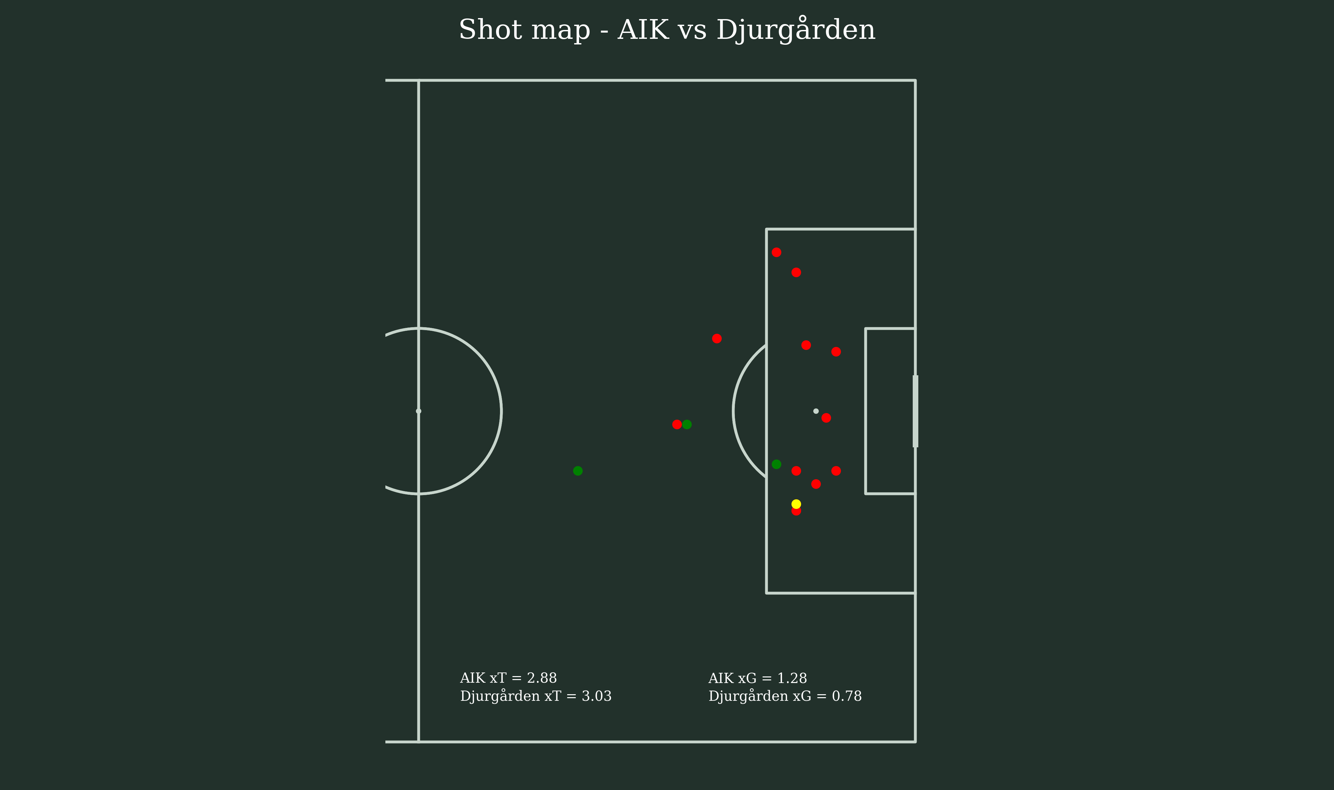
The numbers can confuse

Slide 6
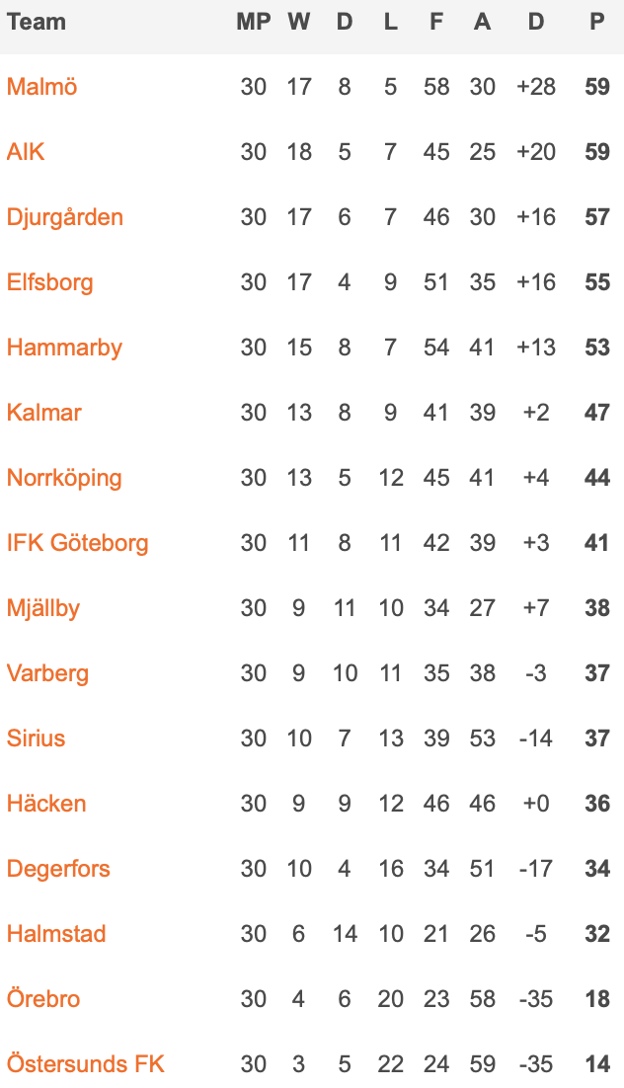
Placement
Team | Weeks at top of league
🥇Malmö FF | 12
🥈AIK | 3
🥉 Djurgården | 16
IF Elfsborg | 0

Slide 7
Expected offensive performance, top 4
Team | xG vs Actual Goals
Malmö FF | -11.24
Aik | -0.02
Djurgårdens IF | -10.89
IF Elfsborg | -5.88

Slide 8
Expected defensive performance, top 4
Team | xG against vs Actual goals against
Malmö FF | -2.07
AIK | 6.58
Djurgårdens IF | 1.04
IF Elfsborg | 0.14

Slide 9
Goal difference, top 4
Team | xG against vs Actual goals against
Malmö FF | -13.31
Aik | 6,55
Djurgårdens IF | -12.85
IF Elfsborg | -5,73

Slide 10



Highlights, learnings, improvements
Working with a dataset which interests me
Diving into established statistical metrics for football
Once again, delimit the problem to smaller tasks.
Keep it relevant
Doubt is part of the process
The code could automate more steps
Work with the statistics available within dataset, before trying to plot

Slide 11
Questions?

